Slide 1




G.H. RAISONI COLLEGE OF ENGINEERING
AND MANAGEMENT, WAGHOLI, PUNE.
Department of AI & AIML
FACE RECOGINTION ATTENDNCE SYSTEM
Guide:
Prof.Amitkumar Shinde
Name of Projectees
Omkar Nikat B-20 Rutuja Nikat B-21
Pravin Shelke B-35 Tapasya Shinde B-37

Slide 2

Contents
Introduction
Justifications for Selecting the Title
Problem Statement
Literature Survey
Block Diagram
Expected Result
Work plan
References

Slide 3

Introduction
Every educational institution necessitates an attendance system to keep a comprehensive record of students' presence. The Faculty has introduced a cutting-edge Face Recognition Attendance System designed to streamline attendance tracking. This system harnesses the power of facial recognition technology to swiftly and accurately identify individuals based on their facial features, making attendance marking significantly more efficient compared to traditional methods.

Slide 4
Justification For Selecting The Title
Relevance: Addresses a significant need in educational and organizational settings.
Technology Trend: Utilizes cutting-edge face recognition and biometric technology.
Practical Application: Offers hands-on experience and applies theoretical knowledge.
Skill Alignment: Matches the team's expertise and capabilities.
Pandemic Response: Promotes contactless attendance, enhancing safety during the pandemic.
Innovation: Integrates modern technology for a forward-thinking project.
Social Impact: Contributes to improved attendance management, benefiting institutions and individuals.
Project Scope: Provides a manageable and focused subject for the minor project.

Slide 5

Problem Statement
Face Recognition Attendance System.
Selecting a face recognition attendance system is justified for its remarkable accuracy, efficiency, and security. It eliminates errors and fraud, offers contactless operation for hygiene and convenience, and quickly records attendance. With audit trail features and scalability, it suits organizations of all sizes. While initial costs may be higher, long-term savings through reduced administrative overhead make it a cost-effective and forward-looking choice for attendance management in various sectors.

Slide 6
Literature Survey
Sr. No. | Paper Title and its Author | Details of Publication | Findings
1 | Face Recognition based Attendance System Author: Dhanush Gowda, K Vishal, Keertiraj B.R, Neha Kumari Dubey, Pooja M.R | Published by : http://www.ijert.org ISSN: 2278-0181 Date of Publication – 6 June 2020 | OpenCV for frame extraction and dlib for face recognition. This method will have higher accuracy in recognition of multiple faces from a single frame with lower response time
2 | Face recognition based Attendance management System Author: Smitha, Pavithra S Hegde, Afshin | Published by : http://www.ijert.org ISSN: 2278-0181 Date of Publication – 5 May 2020 | Detect faces via webcam and then recognize the faces. After recognition, it will mark the attendance of the recognized student and update the attendance record.
3 | Face Recognition Attendance System Author: Shrey bhagat, Vithal Kashkari, Shubhangi Srivarstava, Ashutosh Sharma | Publisher Name : IJRASET Publish Date : 2021-12-30 | Capture a video of people, convert it into frames, link it to a database to ensure their presence or absence, to mark the presence of a real student to keep a record.
4 | Attendance Management System Using Face Recognition Author: Chaitra T.K, M.C.Chandrashekher, Dr.M.Z.Kurian | Publisher Name : JETIR Publish Date : August-2018 | Automate the attendance system by integrating the face recognition technology using modified Local Binary Pattern (LBP) and Support Vector Machine (SVM) algorithm with Matlab Graphical User Interface (GUI).

Slide 7
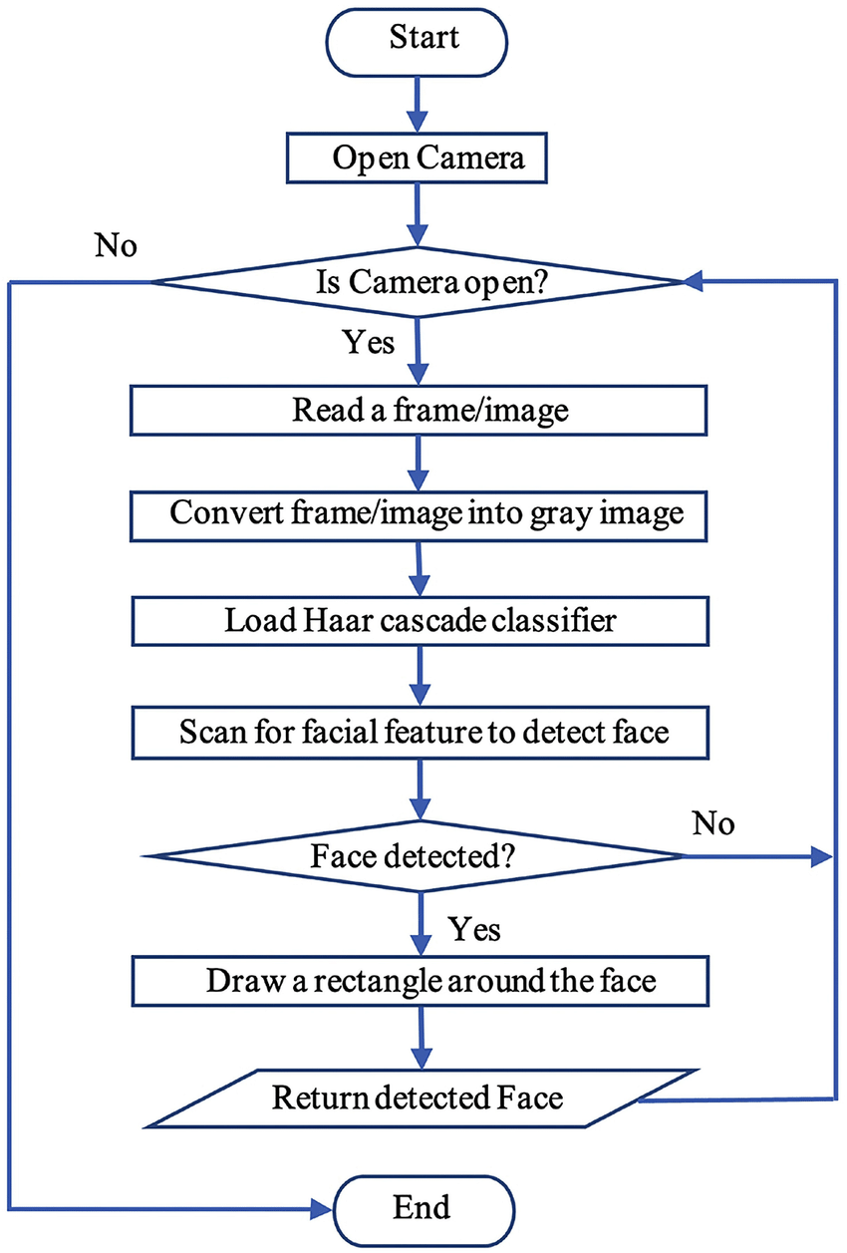
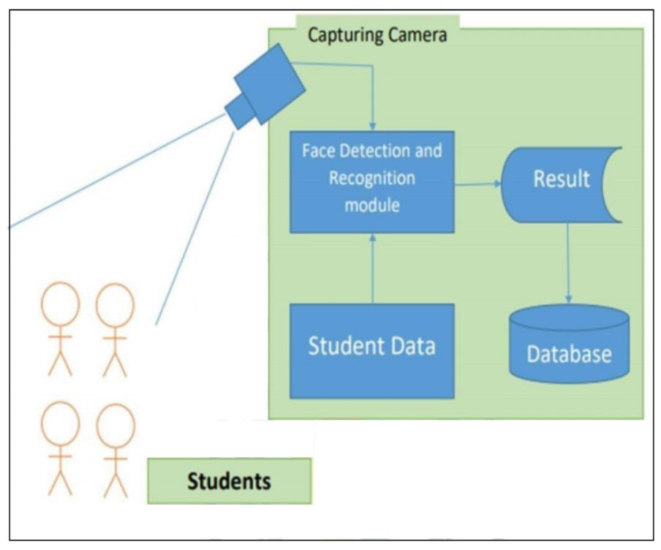
Block Diagram

Slide 8
Expected Result
Accurate Attendance Tracking: Precise identification of individuals for attendance records.
Efficiency: Streamlines attendance management, reducing manual effort.
Real-time Monitoring: Allows immediate tracking of attendance status.
Enhanced Security: Ensures access only to authorized individuals, reducing fraud.
Privacy Compliance: Adheres to data protection regulations, safeguarding personal information.
Convenience: Offers a user-friendly experience for both administrators and users.
Reduces Errors: Minimizes inaccuracies associated with traditional attendance methods.
Time-saving: Increases efficiency in attendance processing, saving valuable time for organizations.

Slide 9
Work – Plan
Months Activities | August’23 | Sept’23 | Oct’23 | Nov’23
Literature Reviews | √
Requirement Analysis | √
Designing | √
Experimental Analysis | √ | √
Module wise Implementation
Testing and Debugging
Preparation of Project Report

Slide 10
References
https://www.researchgate.net/publication/326261079_Face_detection_system_for_attendance_of_class%E2%80%99_students
https://www.researchgate.net/publication/342490735_Face_Recognition_based_Attendance_System
https://www.researchgate.net/publication/341876647_Face_Recognition_based_Attendance_Management_System
https://www.researchgate.net/publication/337590875_Face_Recognition_based_smart_attendance_system_using_IOT
“Attendance System Using NFC Technology with Embedded Camera on Mobile Device” (Bhise, Khichi, Korde,Lokare, 2015)
International Journal of Engineering Trends and Technology (IJETT) – Volume 9 Number 2 - Mar 2014 ISSN: 2231-5381 http://www.ijettjournal.org Page 96 Face Recognition using LBP Coefficient Vectors with SVM Classifier

Slide 11
Thank you !

